Slide 1
Energy-Efficient Neuromorphic Systems using Approximate Computing
Swagath Venkataramani,
Ashish Ranjan, Kaushik Roy
and Anand Raghunathan
Presented by: Arvind Shankar & Quade Kirby

Slide 2
Related Work to be Influenced
Efficient neuromorphic systems
Custom architectures optimized for computation and communication patterns
NN implementations on GPUs
Leverage intrinsic resilience and approximate computing to construct NNs
Approximate computing
Replacing expensive functions
Voltage overscaling
Benefits by exploiting NN properties to maximize results

Slide 3
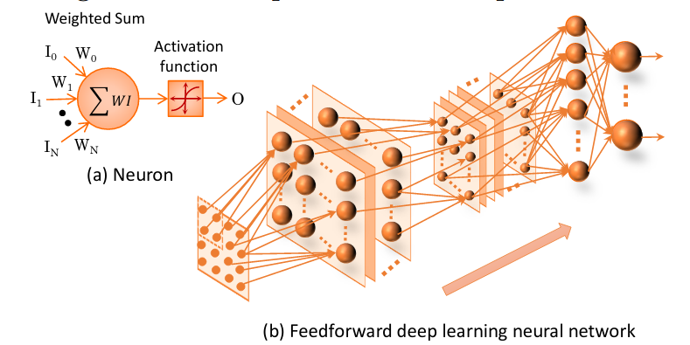
NEURAL NETS: PRELIMINARIES

Slide 4
NEURAL NET TRAINING METHODS
Forward Propagation
Evaluating the outputs of the NN
Inputs are fed to neurons in the first layer
Eventually completed for every layer of the NN
Backpropagation
Stochastic Gradient Descent
Redistributes the error at the output backwards into the NN
Quantifies the error contributed by each neuron

Slide 5
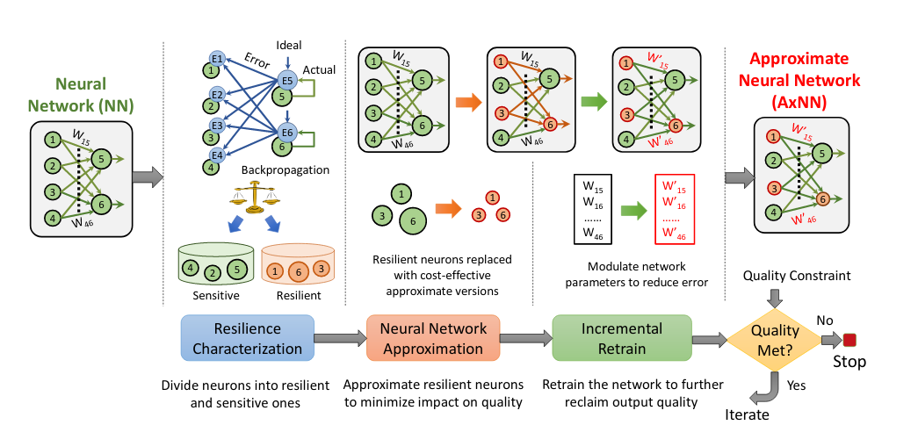
APPROXIMATE NEURAL NETWORKS (AxNN)
1. Backpropagation to characterize the importance of each neuron in the NN
2. Replace less-significant neurons w/ approximate versions that are more energy-efficient
Uses precision scaling
3. Adapt weights by “incrementally retraining” network

Slide 6
APPROACH AND DESIGN METHODOLOGY
Design Approach:
Improving energy efficiency with acceptable lose to quality
Resilience characterization
Approximate designated neurons
Incremental retraining of network with approximated neurons

Slide 7
APPROACH AND DESIGN METHODOLOGY
Neural Network Resilience Characterization:
Backpropagate, then sort neurons based on average error contribution
“Predetermined threshold” used to classify neurons as resilient or sensitive
Note: network parameters not adjusted in this training step
Notes:
Neural Network resilience characterization
Distinguish between sensitive and resilient neurons using backpropagation
Neurons that contribute the least error are the most resilient neurons
Converse is also true
Then sorted from most to least resilient based on the average amount of error produced by a node

Slide 8
APPROACH AND DESIGN METHODOLOGY
Approximation of Resilient Neurons:
“Approximate neurons are inaccurate but cost-effective hardware or software implementations of the original neuron functionality”
Precision scaling used to reduce bit width of inputs to neurons, improving energy efficiency

Slide 9
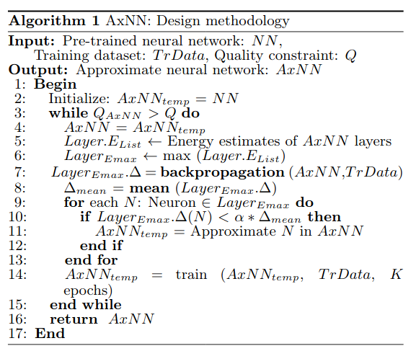
AxNN DESIGN METHODOLOGY
Iteratively build AxNN by successively approximating NN in each iteration
Ensure quality bounds are met
Apply “high-level energy model” of the QC-NPE to estimate energy consumption in each layer

Slide 10
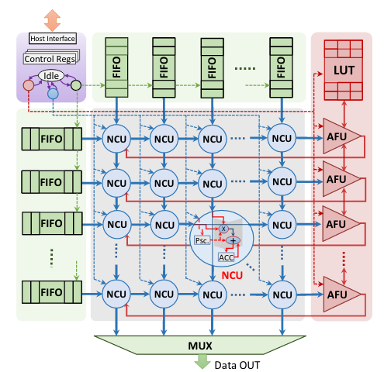
QUALITY CONFIGURABLE NEUROMORPHIC PROCESSING ENGINE (QC-NPE)
Provides a programmable hardware platform for efficiently executing AxNNs
2D array of neural compute units (NCUs)
1D array of activation function units (AFUs)
Precision control register to facilitate execution w/ different accuracies
Notes:
ncus used for multiply-accumulate operation

Slide 11
EXPERIMENTAL METHODOLOGY
QC-NPE implemented in Verilog, mapped to “IBM 45nm technology”
Used Synopsys Power Compiler to estimate energy consumption

Slide 12
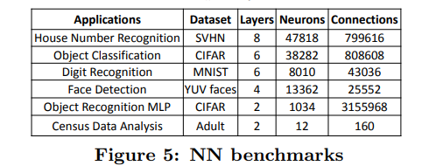
EXPERIMENTAL METHODOLOGY
Benchmarked against 6 popular NN applications for classification & recognition
Used classification accuracy as the error metric

Slide 13
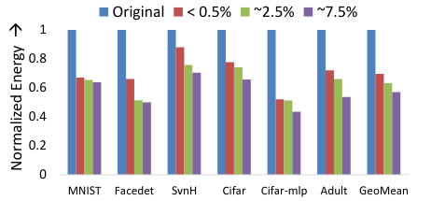
RESULTS - ENERGY COMPARISON
AxNN achieves 1.43X, 1.58X, and 1,75X improvement in application energy for different quality constraints

Slide 14
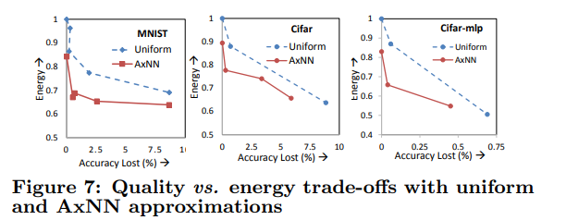
RESULTS - APPROXIMATION COMPARISON
Compared against uniformly approximated NNs for 3 applications
“Naive approach” where NNs that with all neurons approximated
Notes:
This makes sense…?
all neurons approximated vs only some neurons approximated

Slide 15
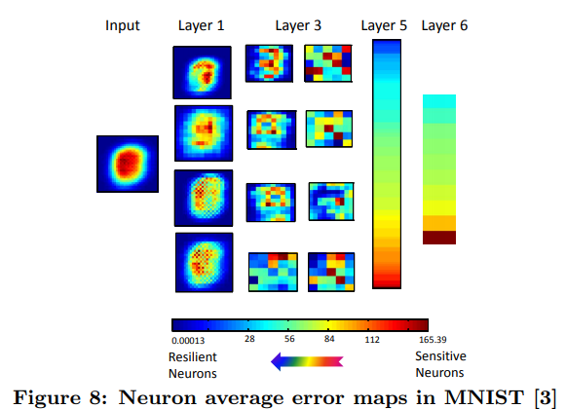
RESULTS - RESILIENCE CHARACTERIZATION
Neurons towards the edges of images become more resilient to approximation

Slide 16
RESULTS - RETRAINING
Quality-per-energy increases with retraining

Slide 17
AxNN ON COMMODITY PLATFORMS
Approximate software implementations of selected NNs
“Approximate neurons” get replaced with approximate but fast piecewise linear function
Runtime speedup of 1.35X with < 0.5% loss in output quality

Slide 18
CONCLUSION
AxNN provides a method for improving energy efficiency of neural networks by approximating neurons that do not contribute to output error
QC-NPE hardware platform to efficiently execute AxNNs

Slide 19
LIMITATIONS
This paper does not mention the datasets used for evaluations - e.g. training or blind test set
MNIST & Cifar can be considered “toy” datasets - may not generalize to other tasks
Doesn’t discuss any methods to counteract overfitting
How is this method of approximating neurons any better/different compared to dropout?

Slide 20
QUESTION 1
What training method do AxNNs use to classify neurons as sensitive or resilient?
Forward Propagation
Backpropagation
Genetic Algorithms
Back Substitution

Slide 21
QUESTION 2
Which of these components do NOT make up a Quality Configurable Neuromorphic Engine(QCNPE)?
FIFO
NCU
LUT
AFU
MUX
LIFO
MCU

Slide 22
QUESTIONS/COMMENTS?

